Slide 1
INTERNSHIP AGREEMENT INSTRUCTIONS

Slide 2
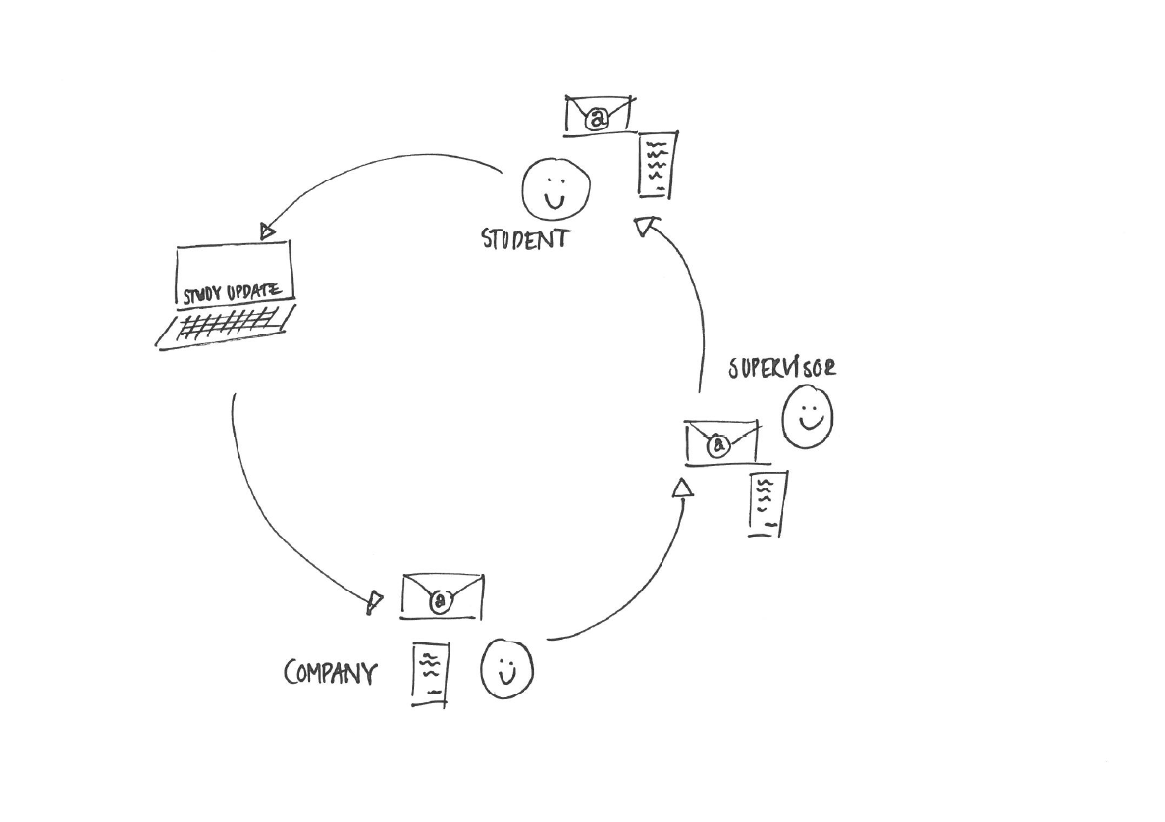

Slide 3
GENERAL INFORMATION
Use the link on Study Update to access the digital internship agreement and enter the relevant data concerning your internship.
The agreement is for two types of internship:
Standard internship: The type of internship where you enter an agreement with a company.
Internship in your own company: The type of internship where you have chosen to be an intern in your own company and where the structure of this internship must live up to certain requirements according to your programme.

Slide 4
BEFORE YOU START
Read these instructions carefully and have the following data ready before you start to complete the internship agreement:
Which type of internship do you want to choose?
Name of company, address, postal code/city, country, phone number, website – of your company
Contact details – first name, last name, phone number, e-mail address – of your contact in the company
Contact details for your supervisor – name and e-mail address
Duration and working hours of the internship
Your learning objectives for the internship – these should be approved by your supervisor BEFORE you add them to your internship agreement.
You can find guidelines for formulating your learning objectives in “Quick reference guide for students: Learning objectives for your internship”. (Ask your supervisor where you’ll find it)

Slide 5
Especially for ‘Internship in your own company’
If you are in ‘Internship in your own company’ you need to have your CVR number ready if possible.
If your business is associated with an entrepreneurial environment, you must also enter the name, address, etc.
If you have affiliated partners or co-owners you must also enter their names.
If included an advisory board or if you have a mentor you must also enter the contact information of those individuals.

Slide 6
APPROVAL
The system generates a PDF file of the internship agreement when you have finished entering the data. This file will be sent automatically to your host company and your supervisor.
They will review the agreement, and if they can approve it you will receive an e-mail with the final agreement attached.

Slide 7
APPROVAL
If they are unable to approve the contents of your agreement, you will receive an e-mail informing you that your supervisor or the company has rejected your agreement and that you should get in touch with them to revise the contents.
If your agreement has been rejected and you have discussed revisions of the contents with the company or your supervisor, you must access the link on Study Update again and create a new agreement.

Slide 8
SUPERVISOR
If the Academy has not yet assigned a supervisor to you when you fill in your internship agreement, you need to consult your programme secretary and use the name and e-mail address of the programme secretary or the programme internship coordinator.
If later in the process you are assigned a supervisor or if you change supervisor during the internship access the link on Study Update again and add the name and e-mail address of your supervisor using the ‘Add new supervisor” button.

Slide 9
The following slides are a survey of the flow in a ‘Standard internship’.
In the case of ‘Internship in your own company’ the questions vary but the principles are the same.

Slide 10
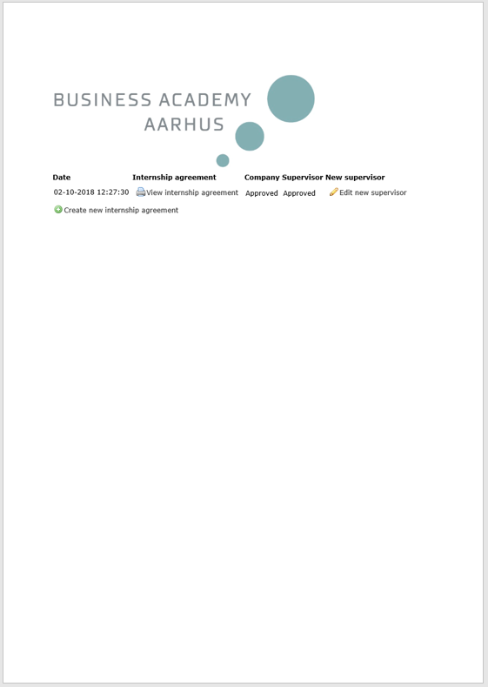
You can always access your agreement using the link on Study Update
You cannot edit an agreement which has been sent but you can create a new agreement if your agreement was rejected.

Slide 11
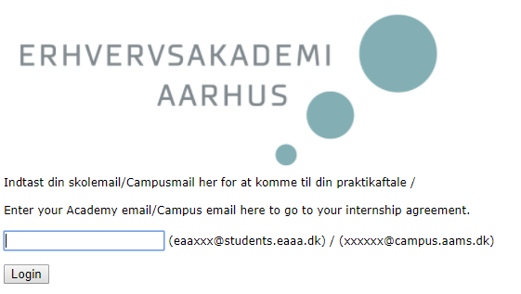
Home
When you have entered your Academy e-mail, you’ll receive an e-mail with a link for your internship agreement.

Slide 12
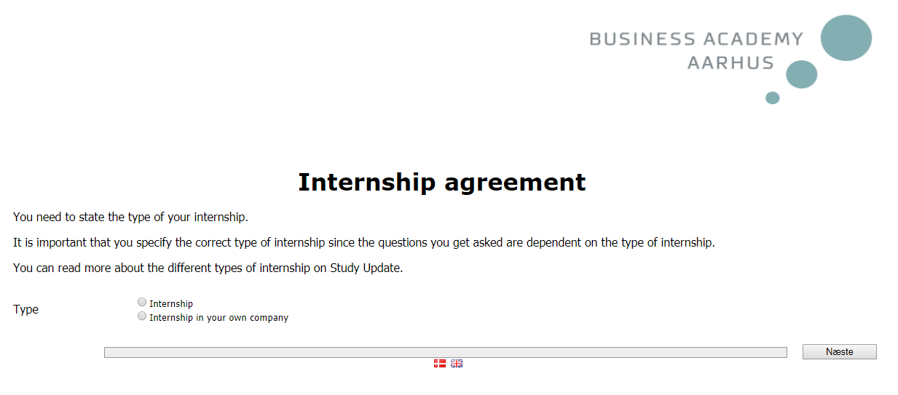
1st screen image
Here you can choose the type of your internship. It’s important to type the exact type of internship as the questions you are asked depend on the type of internship. Please read more about the different types in the beginning of this guide.

Slide 13
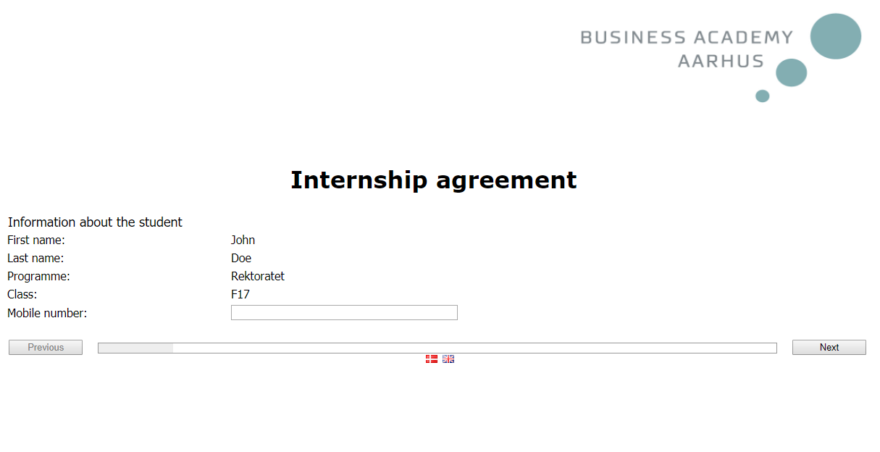
2nd screen image
Your name, programme and the number of your class are filled in automatically. Please add you mobile number if you have one.

Slide 14
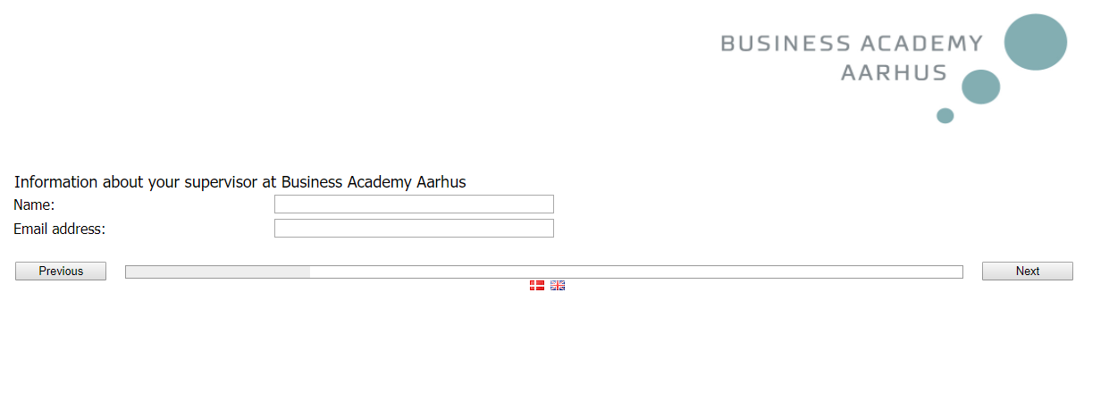
3rd screen image
Please type the correct e-mail of your supervisor at Business Academy Aarhus
otherwise your agreement will not be sent to your supervisor.

Slide 15
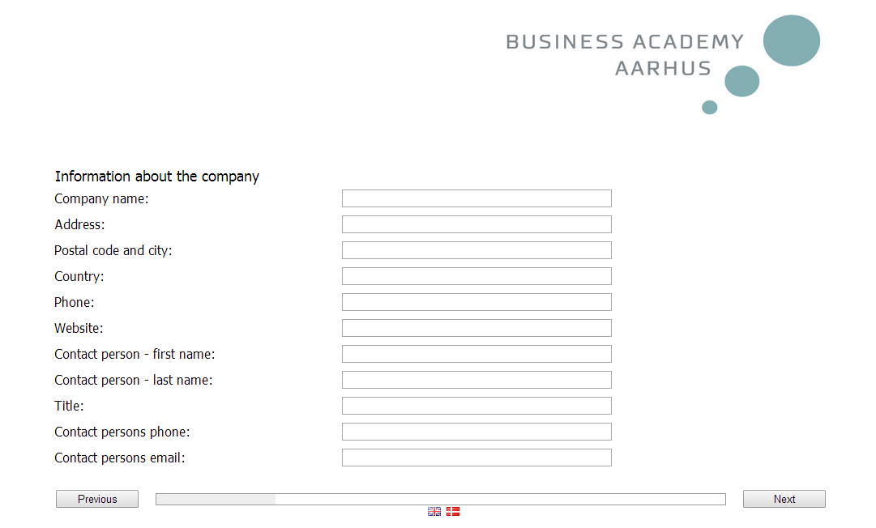
4th screen image
Please type the correct e-mail, otherwise your agreement will not be sent to your contact person in the company

Slide 16
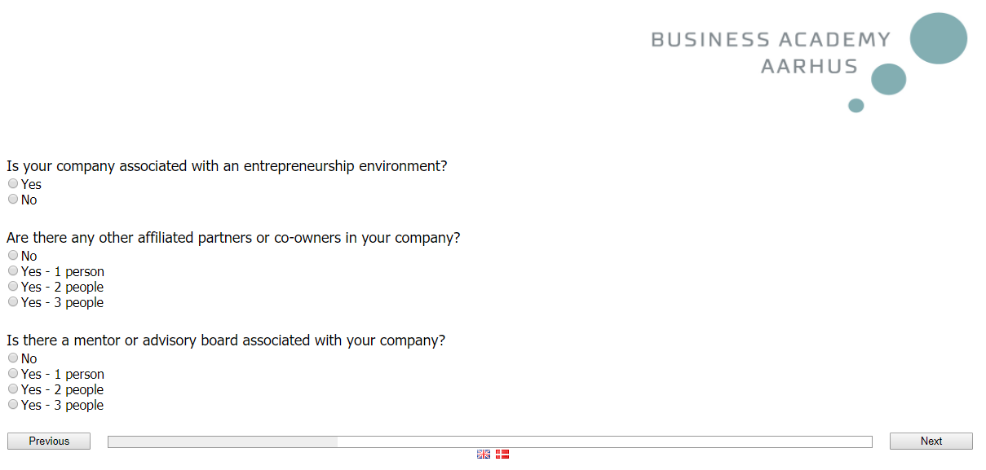
Special frame:
Internship is in a company with its own agreement
If your business is associated with an entrepreneurial environment, you must also enter the name, address, etc.
If you have affiliated partners or co-owners you must enter their names.
If included an advisory board or if you have a mentor you must also enter the contact information of those individuals.

Slide 17
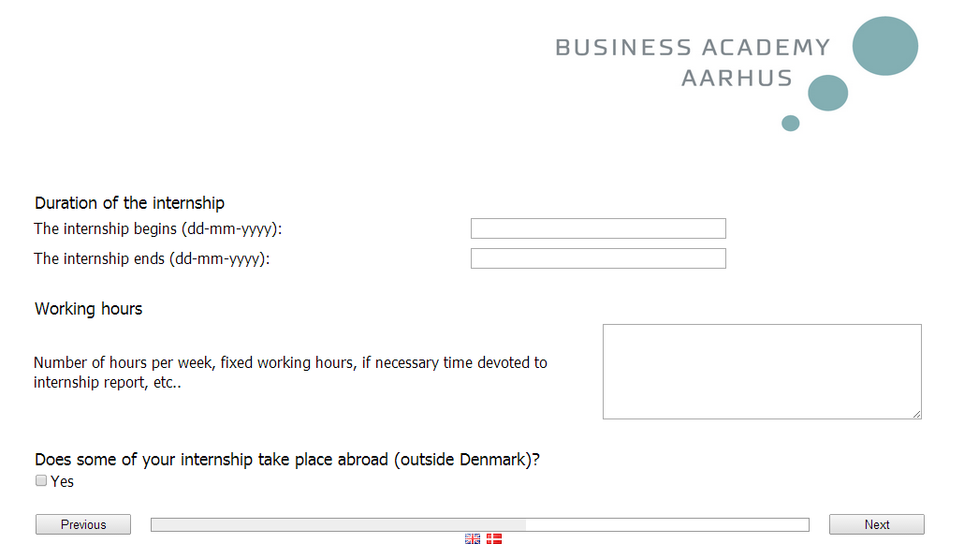
5th screen image
Here you state when your internship starts and ends. State how many weeks you have for your internship, according to your curriculum. You also state relevant details about your working hours.
If a minimum 3 months of your internship take place abroad, you must tick this option.
If you want your company to receive information by e-mail, the internship agreement, evaluation etc. in English, you must tick this option.

Slide 18
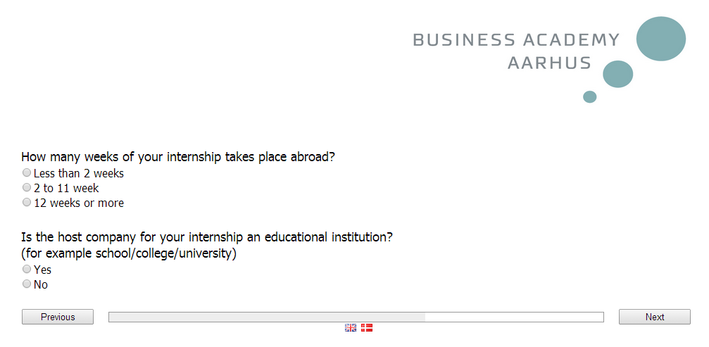
If you have confirmed that your internship takes place abroad, you must state whether the internship is linked to an educational institution and how many weeks you are abroad.

Slide 19
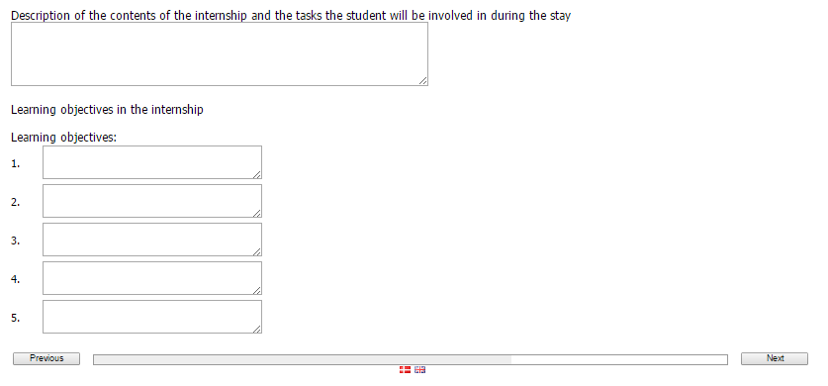
6th screen image
Here you must describe the tasks you have agreed with your host company and your supervisor to carry out during the internship.
You must also describe the individual learning objectives of your internship.
The individual learning objectives are formulated according to the relevant curriculum and inspired by the tasks you need to solve in the company.

Slide 20

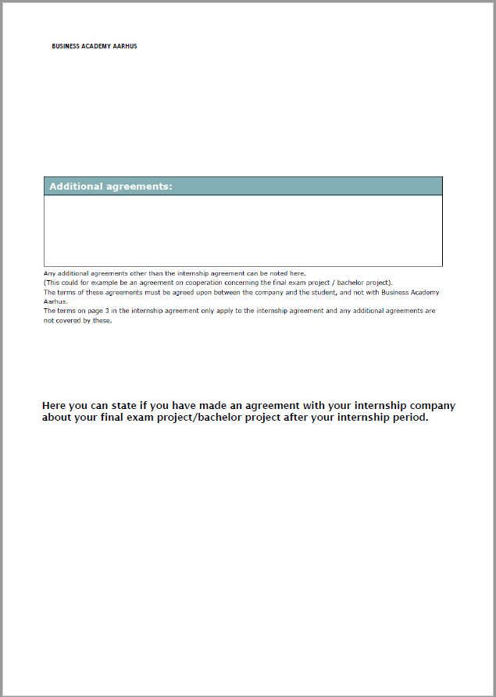

Slide 21
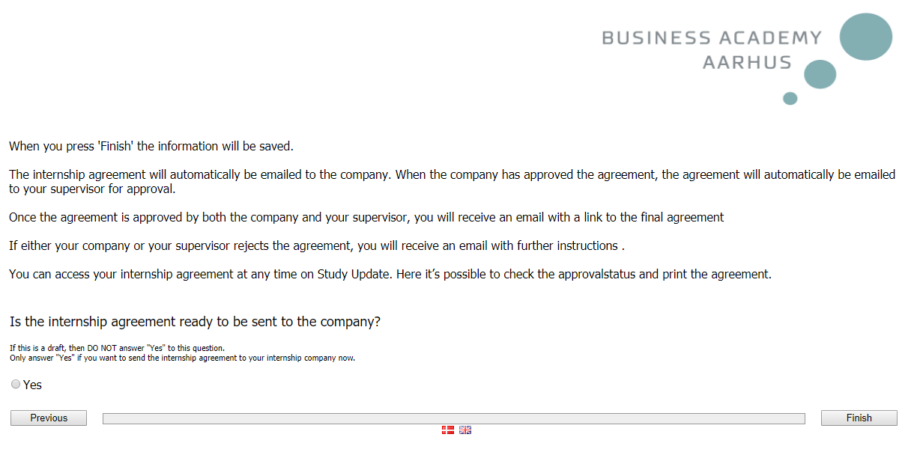
7th screen image
You are now ready to finalise your internship agreement and you will return to the home page where you can see your agreement and verify your approval status.
You can always login to the overview page via the link on Study Update, but you cannot edit a sent internship agreement.
If you need to change the content of your internship agreement, then you need to create a new internship agreement. When you create a new internship agreement in the system, the information will automatically be copied from your previous agreement – you can then simply change it as required before it is once again sent for approval to the internship company and the internship supervisor.

Slide 22

Link to the internship agreement
http://ws.survey-xact.dk/servlet/dk.pls.eaaa.EAAALookupPage
A more thorough guide to your internship agreement can be found in your programmes internship folder on Study Update.
Ask your internship coordinator if you need help to find it.
Opdateret 08.10.2018/aman

